Slide 1

Unit Testing and Error Handling
Error Types, Modules, Unit Testing, Mocha & Chai
SoftUni Team
Technical Trainers
Software University
https://softuni.bg

Slide 2
Table of Contents
Error Handling
Error Types
Exceptions & try/catch block
Unit Testing
The AAA Pattern
Mocha & Chai
2
Notes:
2

Slide 3
Have a Question?
sli.do
#js-advanced
Notes:
3

Slide 4

Error Handling
Concepts, Examples, Exceptions

Slide 5
Error Handling
The fundamental principle of error handling says that a function (method) should either:
Do what its name suggests
Indicate a problem
Any other behavior is incorrect

Slide 6
Error Handling
A function failed to do what its name suggests should:
Return a special value (e.g. undefined / false / -1)
Throw an exception / error
Exceptions are the object-oriented way for errors
let str = "Hello, SoftUni";
console.log(str.indexOf("Sofia")); // -1
// Special case returns a special value to indicate "not found"

Slide 7
Types of Errors
There are three types of errors in programming:
Syntax Errors - during parsing
Runtime Errors - occur during execution
After compilation, when the application is running
Logical Errors - occur when a mistake has been made in the logic of the script and the expected result is incorrect
Also known as bugs

Slide 8
Error Handling – Exceptions (Errors)
Exception - a function is unable to do its work (fatal error)
let arr = new Array(-1); // Uncaught RangeError
let bigArr = new Array(9999999999); // RangeError
let index = undefined.indexOf("hi"); // TypeError
console.log(George); // Uncaught ReferenceError
console.print('hi'); // Uncaught TypeError

Slide 9
Error Handling – Special Values
let sqrt = Math.sqrt(-1); // NaN (special value)
let sub = "hello".substring(2, 1000); // llo
let sub = "hello".substring(-100, 100); // hello
// Soft error - substring still does its job: takes all available chars
let invalid = new Date("Christmas"); // Invalid Date
let date = invalid.getDate(); // NaN

Slide 10
Problem : Sub Sum
Sum a range of elements in array from startIndex to endIndex
Receive three parameters: array, startIndex, endIndex
Handle special cases:
First parameter is not array → return NaN
startIndex < 0 → assume startIndex = 0
endIndex > array.length-1 → assume endIndex = array.length-1

Slide 11
Solution: Sub Sum
function solve(array, startIndex, endIndex) {
if (Array.isArray(array) == false) {
return NaN;
}
if (startIndex < 0) {startIndex = 0; }
if (endIndex > array.length - 1) {
endIndex = array.length - 1;
}
return array
.slice(startIndex, endIndex + 1)
.map(Number)
.reduce((acc, x) => acc + x, 0);
}

Slide 12
Throwing Errors (Exceptions)
The throw statement lets you create custom errors
General Error - throw new Error("Invalid state")
Range Error - throw new RangeError("Invalid index")
Type Error - throw new TypeError("String expected")
Reference Error - throw new ReferenceError("Missing age")
throw new Error('Required');
// generates an error object with the message

Slide 13
Try – Catch
The try statement tests a block of code for errors
The catch statement handles the error
Try and catch come in pairs
try { // Code that can throw an exception // Some other code - not executed in case of error!
} catch (ex) { // This code is executed in case of exception // Ex holds the info about the exception }

Slide 14
Exception Properties
An Error object with properties is created
try {
throw new RangeError("Invalid range.");
console.log("This will not be executed.");
} catch (ex) {
console.log("Exception object: " + ex);
console.log("Type: " + ex.name);
console.log("Message: " + ex.message);
console.log("Stack: " + ex.stack); }

Slide 15

Live Demonstration
Lab Problem 2

Slide 16

Unit Testing
Definition, Structure, Examples, Frameworks

Slide 17
Unit Testing
A unit test is a piece of code that checks whether certain functionality works as expected
Allows developers to see where & why errors occur
function sortNums(arr) { arr.sort((a,b) => a - b); }
let nums = [2, 15, -2, 4]; sortNums(nums);
if (JSON.stringify(nums) === "[-2,2,4,15]") { console.error("They are equal!");
}

Slide 18
Unit Testing
Testing enables the following:
Easier maintenance of the code base
Bugs are found ASAP
Faster development
The so called "Test-driven development"
Tests before code
Automated way to find code wrongness
If most of the features have tests, running them shows their correctness

Slide 19
Unit Tests Structure
The AAA Pattern: Arrange, Act, Assert
// Arrange all necessary preconditions and inputs
let nums = [2, 15, -2, 4];
// Act on the object or method under test
sortNums(nums);
// Assert that the obtained results are what we expect
if (JSON.stringify(nums) === "[-2,2,4,15]") {
console.error("They are equal!");
}

Slide 20

Unit Testing Frameworks
JS Unit Testing:
Mocha, QUnit, Unit.js, Jasmine , Jest (All in one)
Assertion frameworks (perform checks):
Chai, Assert.js, Should.js
Mocking frameworks (mocks and stubs):
Sinon, JMock, Mockito, Moq

Slide 21

Modules
Definition, Import, Export

Slide 22
Modules
A set of functions to be included in applications
Group related behavior
Resolve naming collisions
http.get(url) and students.get()
Expose only public behavior
They do not populate the global scope with unnecessary objects
const loading = {
show() { }, hide() { },
};
a module for loading indicator

Slide 23
Node.js Modules
require() is used to import modules
Internal modules need to be exported before being required
In Node.js each file has its own scope
const http = require('http');
// For NPM packages
const myModule = require('./myModule.js');
// For internal modules

Slide 24
Node.js Modules
Whatever value has module.exports will be the value when using require
To export more than one function, the value of module.exports will be an object
const myModule = () => {...};
module.exports = myModule;
module.exports = { toCamelCase: convertToCamelCase, toLowerCase: convertToLowerCase };

Slide 25

Unit Testing with Mocha and Chai
Installation, Configuration, Approaches

Slide 26
What is Mocha?
Feature-rich JS test framework
Provides common testing functions including it, describe and the main function that runs tests
Usually used together with Chai
describe("title", function () {
it("title", function () { … });
});

Slide 27
What is Chai?
A library with many assertions
Allows the usage of a lot of different assertions such as assert.equal
let assert = require("chai").assert;
describe("pow", function() {
it("2 raised to power 3 is 8", function() {
assert.equal(pow(2, 3), 8);
});
});

Slide 28
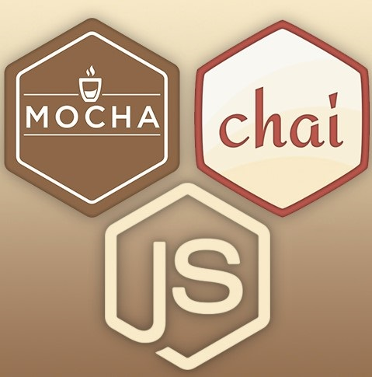
Installation
To install frameworks and libraries, use the CMD
Installing Mocha and Chai through npm
npm init -y
npm init -y
npm install chai
npm i chai mocha
npm install mocha

Slide 29
Usage and Examples
To load a library, we need to require it
const expect = require("chai").expect;
describe("Test group #1", function () {
it("should… when…", function () {
expect(actual).to.be.equal(expected);
});
it("should… when…", function () { … });
});
describe("Test group #2", function () {
it("should… when…", function () {
expect(actual).to.be.equal(expected);
});
});

Slide 30
Live Demonstration
Lab Problems 5 and 6

Slide 31
Unit Testing Approaches
"Code First" (code and test) approach
Classical approach
"Test First" approach
Test-driven development (TDD)

Slide 32
The Code and Test Approach
Write code
Write unit test
Run and succeed
Time flow

Slide 33
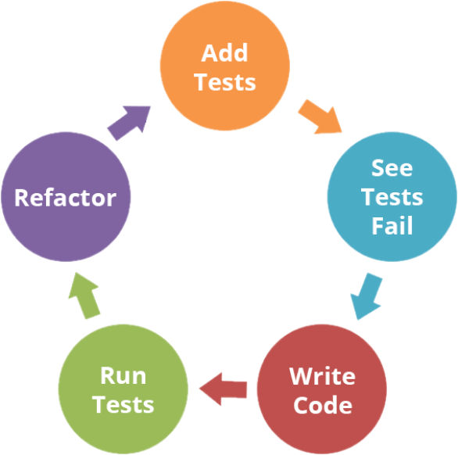
The Test-Driven Development Approach

Slide 34
Test-Driven Development (TDD)
Create a test list
Pick а test
Write test
Compile and fail
Write enough code to compile
Run test and fail
Write code to pass test
Time flow
Remove duplication

Slide 35

Why TDD?
TDD helps find design issues early
Avoids reworking
Writing code to satisfy a test is a focused activity
Less chance of error
Tests will be more comprehensive than if they are written after the code

Slide 36

Summary
…
…
…
Errors in JavaScript
Types & try/catch statement
Modules are a set of functions to be included in applications
Unit tests check if certain functionality works as expected
Mocha is a feature-rich JS testing framework
Chain is an assertion library
Different testing approaches

Slide 37
Questions?
Notes:
37

Slide 38












SoftUni Diamond Partners

Slide 39


Educational Partners

Slide 40

License
This course (slides, examples, demos, exercises, homework, documents, videos and other assets) is copyrighted content
Unauthorized copy, reproduction or use is illegal
© SoftUni – https://about.softuni.bg/
© Software University – https://softuni.bg
Notes:
40

Slide 41
Trainings @ Software University (SoftUni)
Software University – High-Quality Education, Profession and Job for Software Developers
softuni.bg, about.softuni.bg
Software University Foundation
softuni.foundation
Software University @ Facebook
facebook.com/SoftwareUniversity
Software University Forums
forum.softuni.bg
Notes:
41

